Slide 1
SIMBA: single-cell embedding along with features
Huidong Chen, Jayoung Ryu, Michael E. Vinyard, Adam Lerer & Luca Pinello (2023)
Nature Methods
Chen, Yi-Jie
2023/11/20

Slide 2
先前沒讀到的細節補充
連接 scRNA 和 scATAC 數據，是先總結 scATAC 數據中的 accessible 區域來計算基因得分，再透過類似批次校正的過程，在不同組學的細胞之間推斷共享基因表達模塊的邊緣
圖構建之後，使用 PyTorch ，去進行 PBG(PyTorch-BigGraph) Training，不過SIMBA的技術是基於 PBG 框架去修改的 (1) Type-constrainted negative sampling (2) Introducing a weight decay procedure to solve overfitting problem
Notes:
Weight decay的工作原理：
在模型的損失函數中，加上一個與模型權重的平方值成比例的懲罰項。
這個懲罰項鼓勵模型的權重保持較小的值，這通常可以使模型變得更簡單，並減少過度擬合的可能性。
"decay" 在這裡意味著隨著訓練的進行，模型的權重會趨向於變小，除非數據有強烈的證據支持更大的權重值

Slide 3
評估多組學整合性能的指標們(待補)
- Anchoring Distance
- Anchoring Distance Rank, ADR
- Silhouette Index
- Fraction in the Same Cluster
https://chat.openai.com/share/09a2f970-566f-4be9-b8db-0b3829d0c12d
Notes:
锚定距离（Anchoring Distance）、锚定距离等级（Anchoring Distance Rank, ADR）、Silhouette指数和同一簇中的比例（Fraction in the Same Cluster）
锚定距离（Anchoring Distance）
定义：Dou等人（2020）提出的一种指标，用于测量两种模态（例如 RNA 和 ATAC）中匹配细胞之间的归一化距离。
计算方式：考虑欧几里得距离，并通过与随机细胞对之间计算的距离的平均值进行归一化。随机采样的细胞对数设置为细胞总数的10%。
锚定距离等级（Anchoring Distance Rank, ADR）
定义：考虑到锚定距离没有考虑细胞的局部密度，提出了一种新的度量方法 ADR。
计算方式：对于每个细胞 Xi​（具有细胞标识 i 和模态 j），计算该细胞与另一模态 ′j′ 中所有其他细胞的距离。其中 N 是细胞总数。然后，将 Xi​ 与 ′Xj′​ 之间的距离在计算出的距离中的排名归一化，归一化的排名即为 ADR。
意义：对于每个细胞，锚定排名为 0 表示理想的模态整合性能，因为匹配的细胞在嵌入空间中彼此最接近。
Silhouette 指数
计算方式：基于簇分配计算。其中每个簇包含来自 scRNA-seq 数据集和 scATAC-seq 数据集的两个细胞。
同一簇中的比例（Fraction in the Same Cluster）
计算方式：计算两种模态中匹配细胞处于同一簇中的比例。细胞的簇通过使用 Louvain 算法生成，簇的数量等于数据集中细胞类型的数量

Slide 4
Negative samples are produced in two ways
by corrupting the edge with a source or destination sampled uniformly from the nodes with the correct types for this relation;
通過從具有正確類型的節點中均勻抽樣的源或目的地來破壞邊緣 (零節點生成)
by corrupting the edge with a source or destination node sampled with probability proportional to its degree.
通過將邊緣與源節點或目標節點進行腐敗，並以與其度數成比例的概率進行抽樣。(錯誤連接)

Slide 5
The resulting graph embeddings have two desirable properties
First-order similarity
Second-order similarity
(也有機會可以問問林峻宇老師，和上課內容做一個連結)
Softmax transformation
不同類型的實體可能位於潛在空間的不同流形上
為使不同類型的實體嵌入可比較，對功能嵌入進行了Softmax變換
批次校正或多維集成的情況下，也根據不同批次或模式的細胞的一階相似性執行SoftMax變換
Notes:
不同類型的實體可能位於潛在空間的不同流形上：由於不同類型的實體（例如細胞與峰值，或不同批次或模式的細胞）在圖中有不同的邊分佈，因此它們在潛在空間中可能有不同的表示
為使不同類型的實體嵌入可比較，對功能嵌入進行了Softmax變換：使用Softmax函數對特徵嵌入進行變換。變換基於細胞（參考）與特徵（查詢）之間的一階相似性
在批次校正或多維集成的情況下，也根據不同批次或模式的細胞之間的一階相似性執行SoftMax變換：當處理來自不同來源（例如不同的批次或技術）的數據時，為了使這些數據在同一潛在空間中可比較，也對其進行了Softmax變換

Slide 6
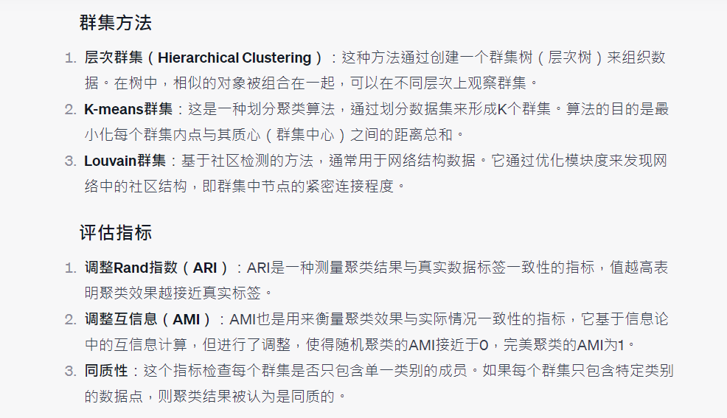
有關於 Clustering 的問題 (WED)

Slide 7
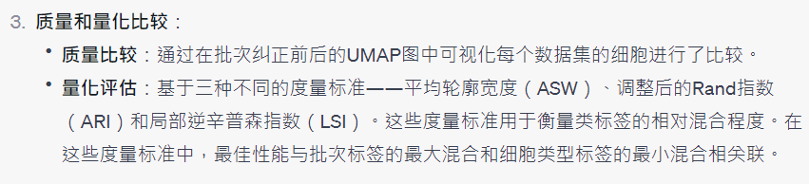
有關於 Clustering 的問題 (WED)

Slide 8
針對我未來在實驗室的研究
資料收集(檢體收集方向)
多模態資料模型建立？

Slide 9
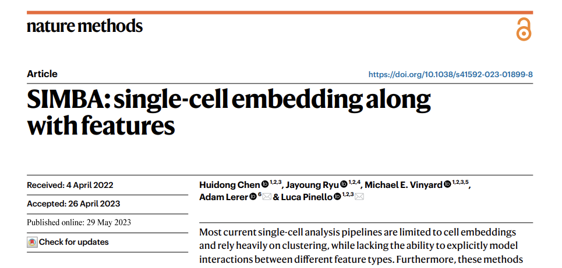
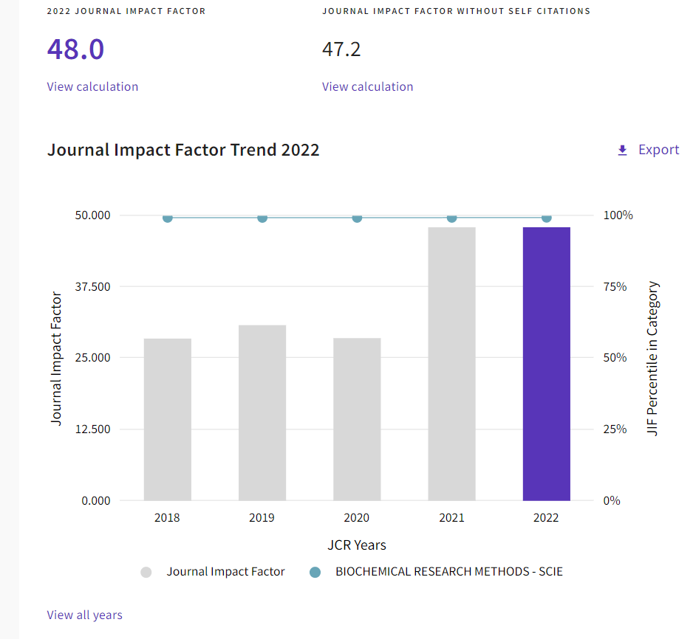
https://jcr.clarivate.com/jcr-jp/journal-profile?journal=NAT%20METHODS&year=2022&fromPage=%2Fjcr%2Fsearch-results
Notes:
And many of us know, papers published in 'Nature Methods' are based on methodologies, so their citation numbers are naturally higher, leading to very high impact factors.

Slide 10
Background
Most current single-cell analysis pipelines rely heavily on clustering
False Discovery (just because they are clustered by similar characteristics)
Lots of single-cell computational methods are developed for the analysis of one modality
….these are also our obstacles
Notes:
But before introducing SIMBA. I would like to first discuss the current challenges in single-cell analysis.
The first one is “Most current single-cell analysis pipelines rely heavily on clustering”, it may lead to False Discovery.
What is false discovery? It is like you group two genes together based on some similar characteristics, for example, high expression level.
However, this can be a random error. It is possible that two genes are not related.
The similarity you see might just be a coincidence, rather than the reason you explained.
The second challenge is many computational methods nowadays in single-cell analysis are developed for one modality.
One modality means there is only one data type. For example, the computational method is only suitable for RNA data, or for proteomics data, or for methylation data.
So actually, we don’t have suitable methods to analyze multiple different types of data simultaneously.

Slide 11
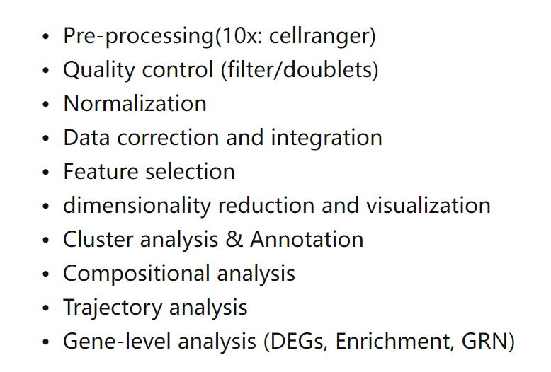
General Workflow for scRNA Analysis
https://www.embopress.org/doi/full/10.15252/msb.20188746
Notes:
This is a picture captured by a paper which summarizes the steps of mainstream scRNA analysis currently in use.
You can clearly see that the cluster analysis is right above.
You can regard clustering as an important step for scRNA alaysis.

Slide 12
The Limitation of Clustering
Presumed Number of Groups
Non-linear Structures and Continuous Variation
Sensitivity to Noise and Outliers

Slide 13
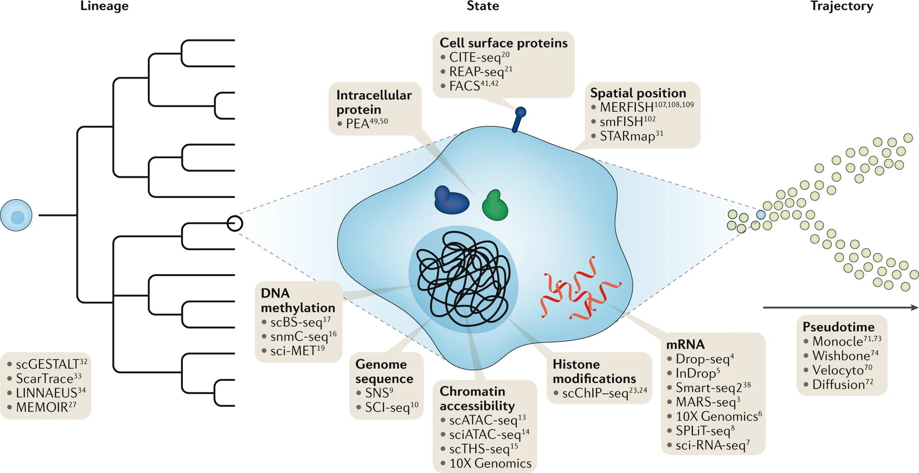
Notes:
Here we can see there are so many information in single cell. For instance, (methylation, genome sequence, chromatin accessibility and also mRNA.)

Slide 14
This is what SIMBA want to ACHIEVE
An clustering-free approach
Building the model considering interactions between different feature
A graph embedding method

Slide 15
This is what SIMBA want to ACHIEVE
A graph embedding method
a common latent space
Cell
mRNA (scRNA)
Chromatin Accessibility (scATAC)
TF motif
DNA sequence
Notes:
When we collect multiple different types of data, we regard them as a feature. And we input this feature, embedding them on a 2D graph.
We employ some techniques and computational methods to identify the relationships between these features, and then we connect these features, these nodes together.

Slide 16
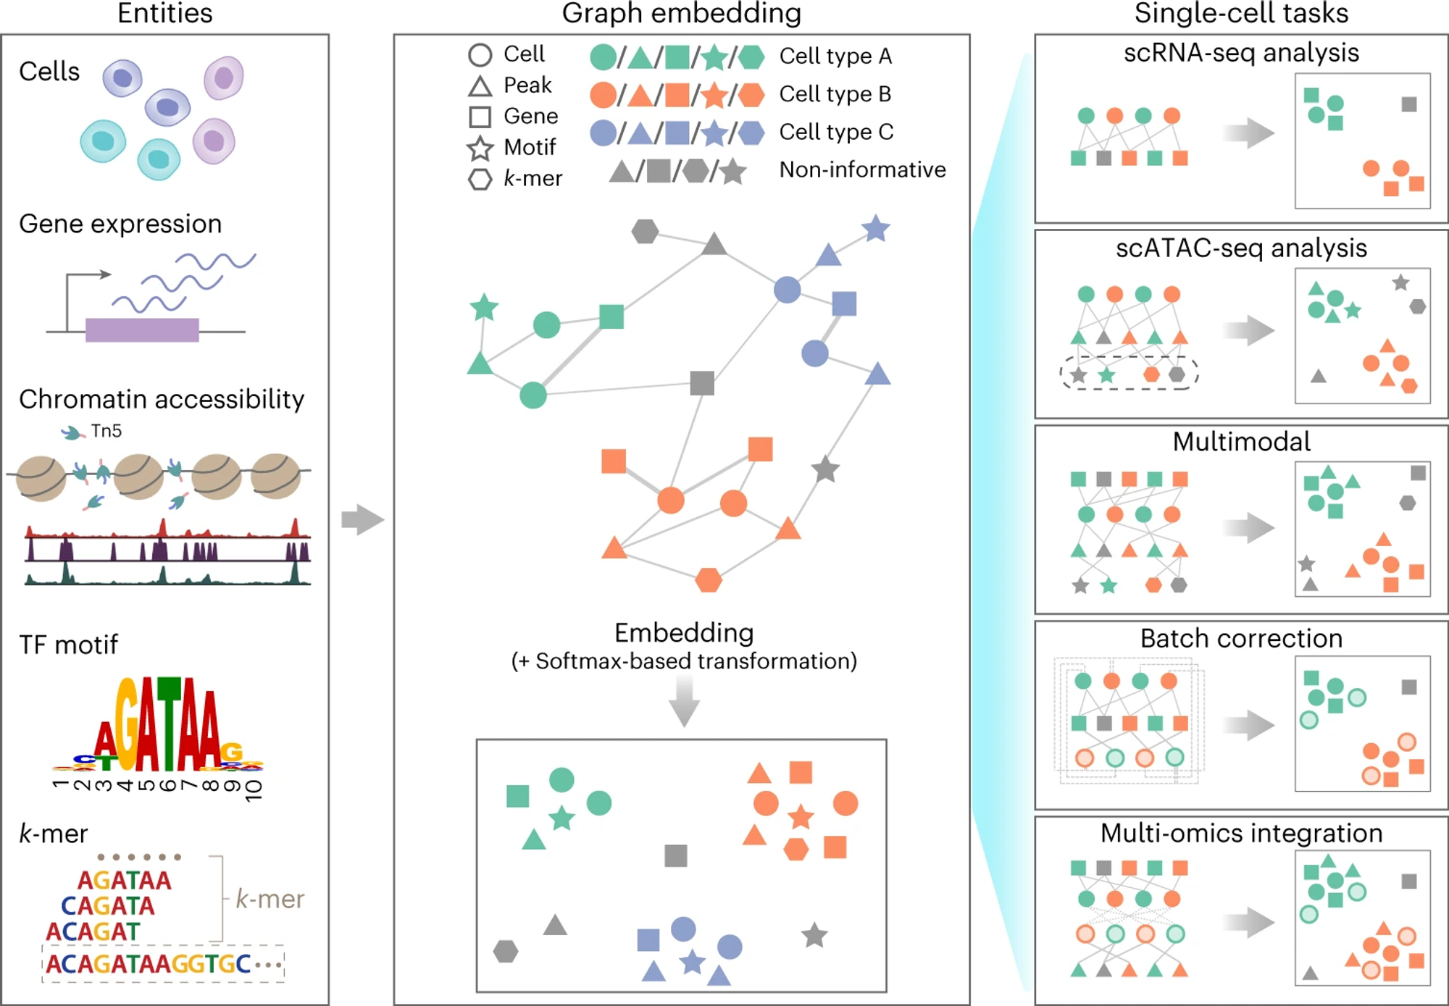
Notes:
In the analysis workflow of SIMBA, five types of data are collected.
Let me spend a little time to explain these data format. I think you guys are familiar with cells and gene expression, but maybe not that familiar with these three types.
Let’s explain TF motif first, TF refers to “Transcription Factor”, transcription factors are specialized proteins that play a crucial role in turning genes on or off.
They do so by recognizing and binding to specific short sequences of DNA, referred to as "TF motifs“, a specific sequence of DNA that can be bound by transcription factors
Chromatin accessibility, reveals which regions of the DNA within a cell are accessible to transcription factors. If there is a high peak, means the region is accessible for transcription factors.
k-mer, ummm….k refers to number, so "k-mer" refers to a substring of DNA that is "k" nucleotides long. Basically, k-mer can let us know the frequency, how many times these fragments had shown up.
And knowing this we can assess the similarities between sequences.
These Data will be transformed to different signature, which means these nodes. Then be placed onto a graph, and certain computational methods are utilized to find associations, then connecting these nodes. We call this process “Embedding”. After Embedding, we employ softmax transformation, we are able to identify the relationship between these cells, genes, chromatin accessibility, TF motif, and k-mer. Dividing different cells and features to different groups based on their association.
And this kind of embedding, or this kind of method. Could be used to multiple single-cell tasks. RNA, ATAC, multimodal, batch correction and multi-omics integration.

Slide 17
SIMBA 和別人不同的地方
SIMBA首先將不同類型的實體，如細胞、基因、開放染色質區域（峰值或區間）、轉錄因子（TF）圖譜，以及k-mer（特定長度的短序列，k）編碼成單一圖表，其中每個節點代表一個個體實體，邊線表示實體之間的關係。與現有的主要專注於學習細胞狀態的方法不同，SIMBA將細胞和特徵視為同一圖表中的等同節點。
當我們說"其他方法主要關注於細胞的狀態"，我們是指其他分析單細胞數據的方法傾向於專注於描述和理解細胞在某一特定時間點的特定狀態或條件。細胞的狀態可以是由細胞的基因表達、功能或其他生物標誌物來定義的。
舉例來說，當研究者分析單細胞RNA序列數據時，他們可能會尋找哪些基因在特定細胞類型或在特定條件下被上調或下調。這些基因表達的模式可以提供細胞當前的功能狀態或響應。
所以，當我們說其他方法主要關注於細胞的狀態，意思是這些方法的主要目標是理解細胞在某個時間點的特性和功能，而不是同時考慮細胞和其他相關特徵（如基因、轉錄因子等）之間的關係，這是SIMBA方法所強調的。

Slide 18
SIMBA 的方法
SIMBA（SIngle-cell eMBedding Along with features）是一種圖嵌入方法，該方法將單細胞及其定義特徵（如基因、染色質可訪問區域和DNA序列）共同嵌入到一個共享的潛在空間中。SIMBA明確地學習細胞和特徵的低維度表示，並隱含地實現了無需聚類的標記發現、批次效應消除和多組學整合的可能性。重要的是，SIMBA引入了幾個關鍵程序，包括Softmax轉換、權重衰減以控制過度擬合，以及實體類型約束，以產生可比較的細胞和特徵的共嵌入（共嵌入），並解決單細胞數據中的獨特挑戰。

Slide 19
邊緣的添加方式
在SIMBA中，邊緣可以以兩種方式添加：1）實驗測量；2）計算推斷。對於實驗測量的邊緣，每個細胞特徵邊緣對應一個單細胞測量（例如，細胞中觀察到的基因或染色質可訪問峰的表達值）。例如，如果一個基因在細胞中被表達，則在該基因和細胞之間創建一個邊緣。這個邊緣的權重由基因表達水平決定。
同樣，如果該區域在此細胞中打開，則在細胞和染色質區域之間添加一個邊緣。也允許在不同特徵之間的邊緣，以捕捉和模擬底層的調控機制。例如，染色質區域和TF-motif（或k-mer）之間的邊緣捕捉到TF可能綁定到包含特定DNA序列的調控區域的概念。對於不能直接測量的邊緣，它們是通過總結相同或不同類型的特徵來計算推斷的。不同批次或模式的細胞之間的每個邊緣都表示細胞功能或結構的相似性。

Slide 20
圖形構建之後
???????????
一旦輸入圖形被構建，SIMBA會應用多實體圖形嵌入算法以及基於Softmax的轉換來將節點/實體嵌入到一個共享的低維空間中，其中細胞和特徵可以進行比較並根據它們的距離進行分析。圖形構建本質上具有靈活性，使SIMBA能夠被應用到各種單細胞任務中

Slide 21
幾個重要問題
Softmax 轉換在 embedding 前後都有嗎？
實體類型約束是什麼？
為什麼要用 k-mer?
Optional

Slide 22
Results
Notes:
After explaining so much, let’s move to result.

Slide 23
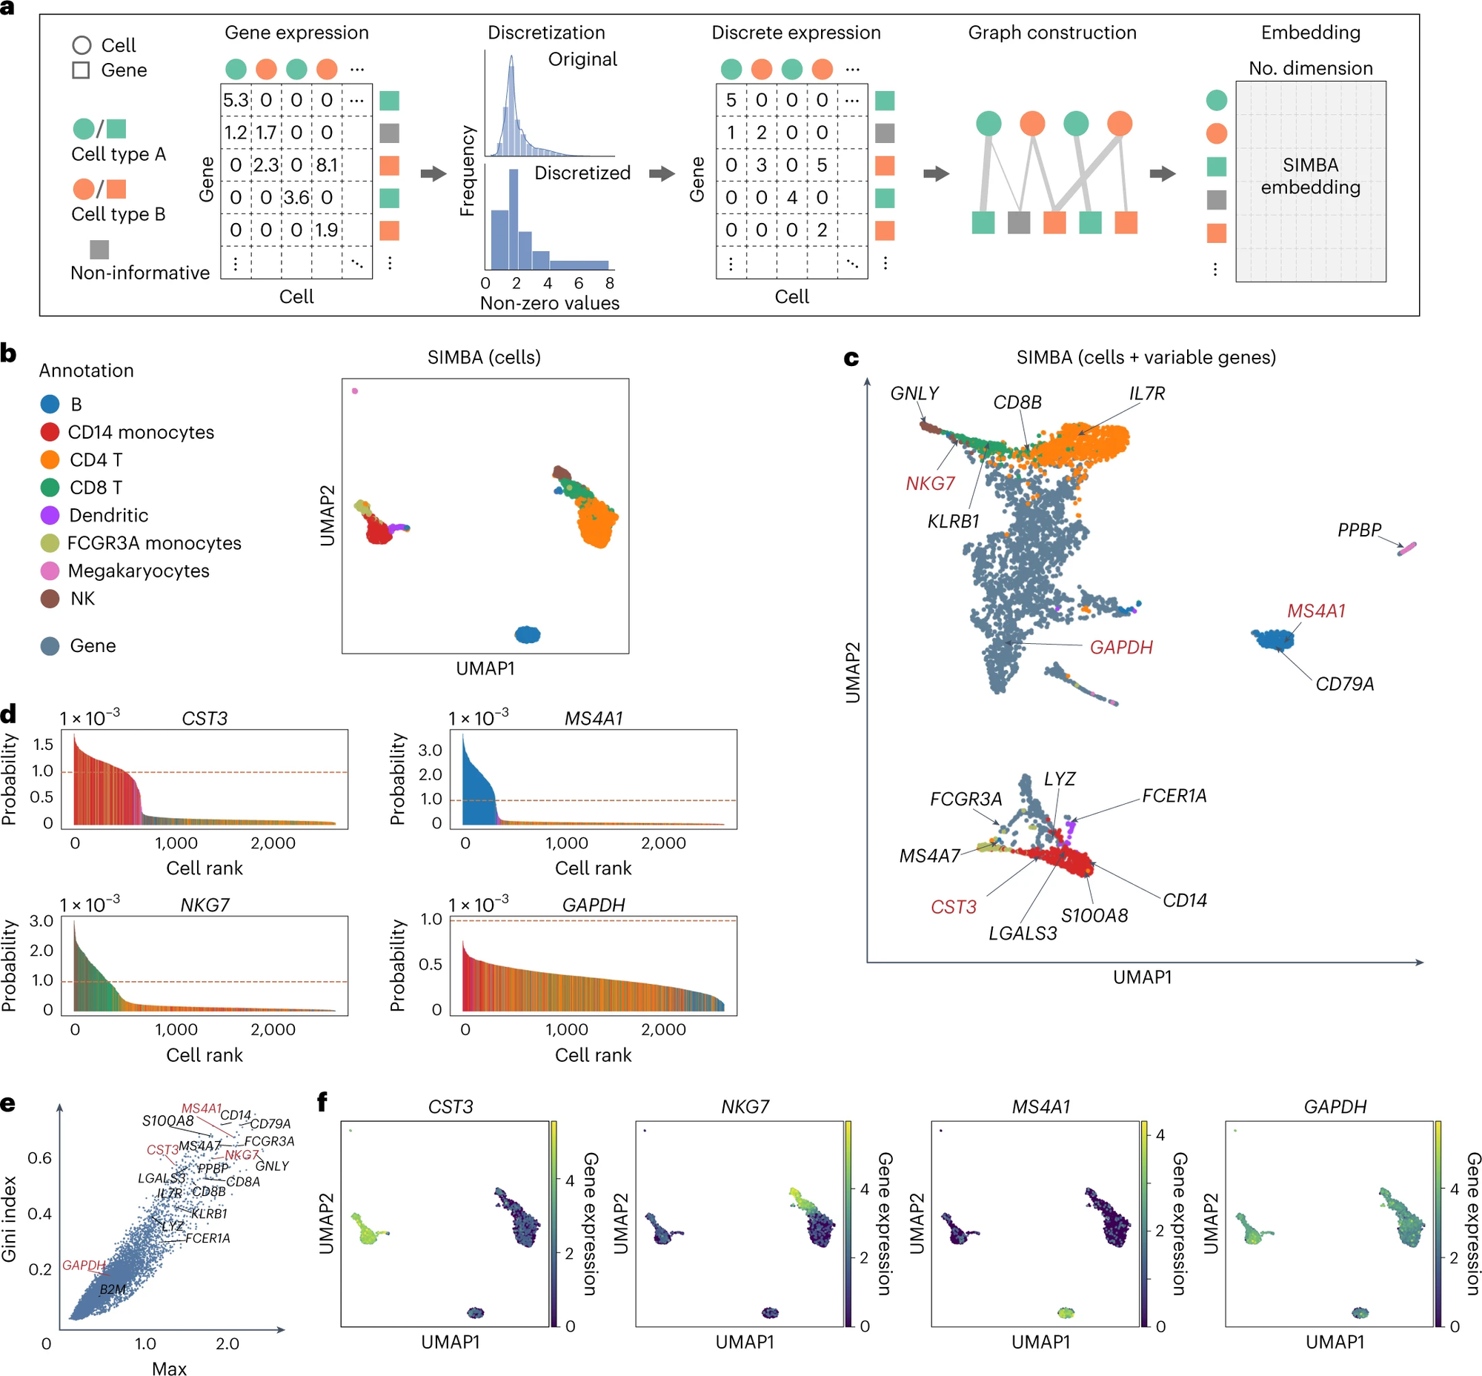
Single-cell
RNA-seq
analysis
Dataset: 10x Genomics PBMCs
Notes:
In fact, for SIMBA, I think result may not be the most important. Because comparing to result, the methodology, method is somewhat more important. Therefore, I won't spend too much time on the results.
This is an example of SIMBA being used for single-cell RNA-seq analysis.

Slide 24
Single-cell
RNA-seq
analysis
Dataset: 10x Genomics PBMCs
Notes:
(b) SIMBA (cells) 投影:
這是一個UMAP可視化，它展示了基於SIMBA嵌入方法的細胞的2D投影。
每個點代表一個單獨的細胞，顏色代表細胞的類型或標籤。
該圖顯示了不同細胞類型的空間分佈，這有助於我們理解細胞間的關係和相似性。
(c) SIMBA (cells + variable genes) 投影:
這個投影不僅顯示了細胞，還展示了變異基因的位置。
這幫助我們理解特定基因如何與特定細胞群體相關聯。
(d) 基因表達概率分佈:
這四個圖展示了特定基因（如CST3, MS4A1等）的表達概率。
Y軸表示概率，而X軸表示基於該基因表達量的細胞排名。
這些圖表幫助我們理解這些基因在所有細胞中的表達情況，並識別哪些細胞在這些基因上有高或低的表達。
(e) Gini index 投影:
這個UMAP投影展示了基於Gini指數的細胞投影。
Gini指數通常用於衡量不均等性，這裡可能用於評估基因表達的異質性。
顏色的變化可能表示Gini指數的大小，這有助於我們了解哪些細胞或區域在基因表達上更加異質。
(f) 特定基因在UMAP上的表達:
這些圖展示了在UMAP空間中特定基因的表達模式。
顏色的深淺表示基因的表達量，這有助於我們理解這些基因在不同細胞群體中的表達情況。

Slide 25
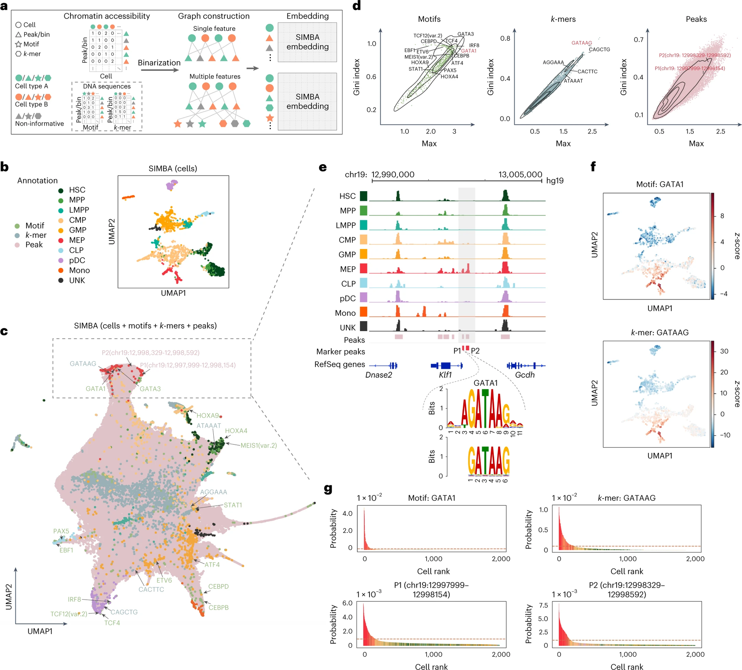
Single-cell ATAC-seq analysis
Dataset:
human hematopoiesis
Notes:
The next application is single-cell ATAC-seq analysis.
Uhh..ATAC-seq is a sequencing method which can provides insights into the chromatin accessibility landscape of individual cells.

Slide 26
SIMBA Indication（Max Value & Gini Index Score）
Dataset: human hematopoiesis

Slide 27
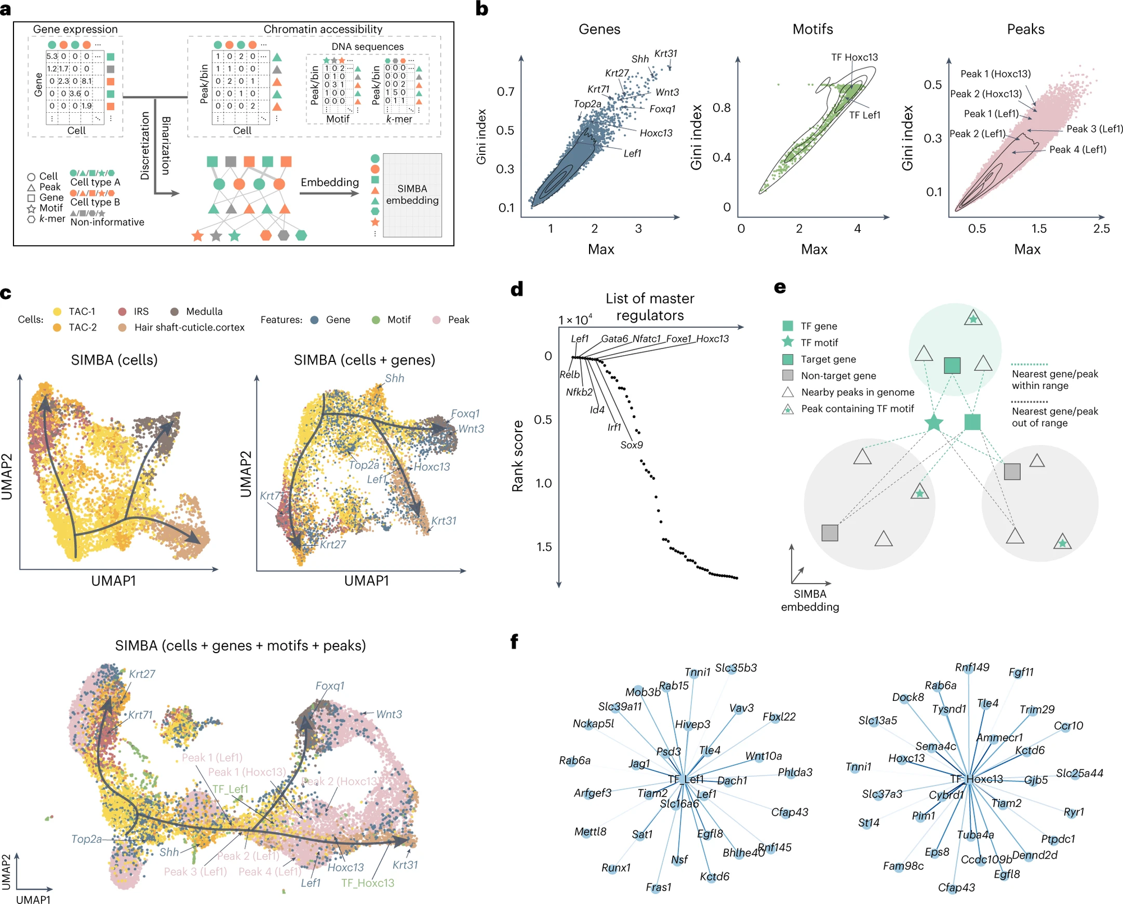
Multimodal analysis
Dataset: SHARE-seq hair follicle
Notes:
The third application of SIMBA, is Multimodal analysis, which means considering more than one data type in single cell analysis.
For instance, you can consider both Single-cell RNA and ATAC sequencing data, incorporating them into a unified analytical framework."
*SHARE-seq enables simultaneous measurement of the RNA data and ATAC data in single cells.

Slide 28
Notes:
Because the sample used here is hair follicles, so …
Through cell annotation and marker gene, we can get the differentiation information from hair follicle

Slide 29
Notes:
Because the sample used here is hair follicles, so …
Through cell annotation and marker gene, we can get the differentiation information from hair follicle

Slide 30
Notes:
Because the sample used here is hair follicles, so …
Through cell annotation and marker gene, we can get the differentiation information from hair follicle

Slide 31
Notes:
Because the sample used here is hair follicles, so …
Through cell annotation and marker gene, we can get the differentiation information from hair follicle

Slide 32
SIMBA Indication（Max Value & Gini Index Score）
Dataset: SHARE-seq hair follicle

Slide 33
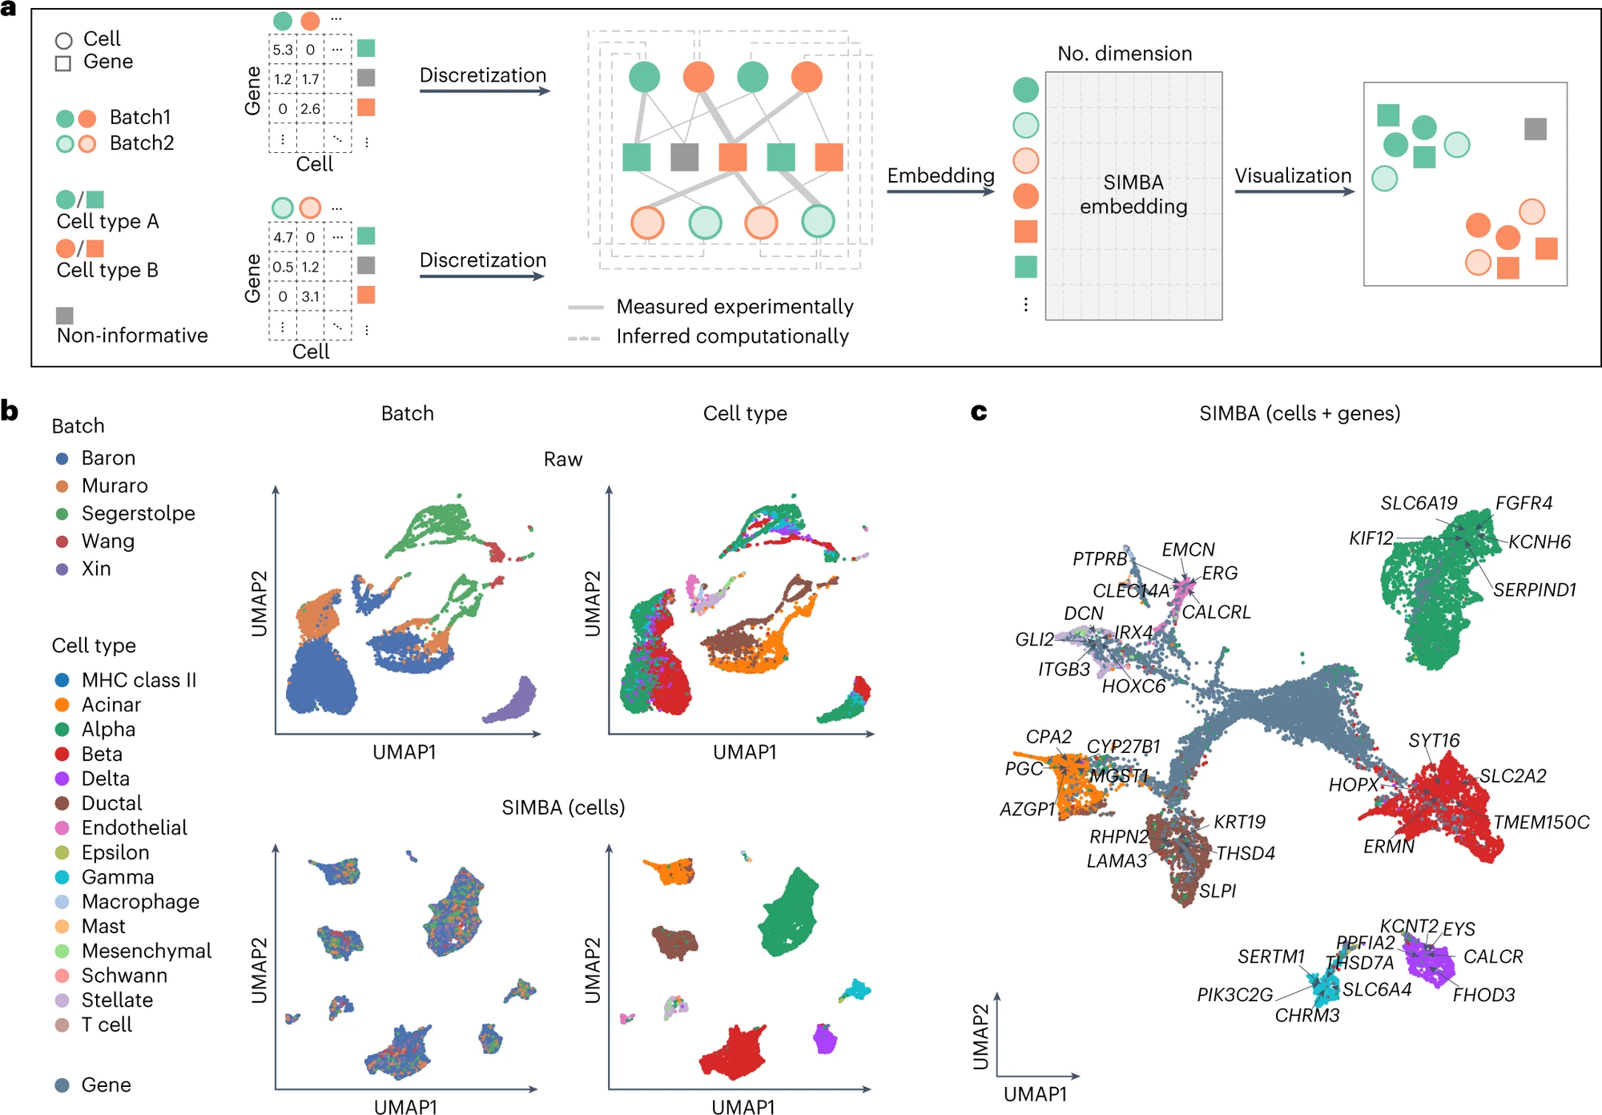
Batch correction analysis
Dataset: scRNA-seq data
Notes:
Okay, so we move to Batch correction analysis.
The top figure presents the UMAP visualization before batch correction.
The bottom figure displays the UMAP visualization after batch correction using SIMBA.
一個由兩個批次組成的小鼠組織圖譜數據集 (小鼠組織圖譜數據集包含來自不同测序平台的共享細胞類型的兩個單細胞RNA序列數據集)
，以及一個包含五個批次的人類胰臟數據集 (人類胰臟數據集包含從五個來源中使用四種测序技術混合的五個樣本)

Slide 34
Batch correction analysis
Dataset: scRNA-seq data
Notes:
And here we have known marker genes highlighted.

Slide 35
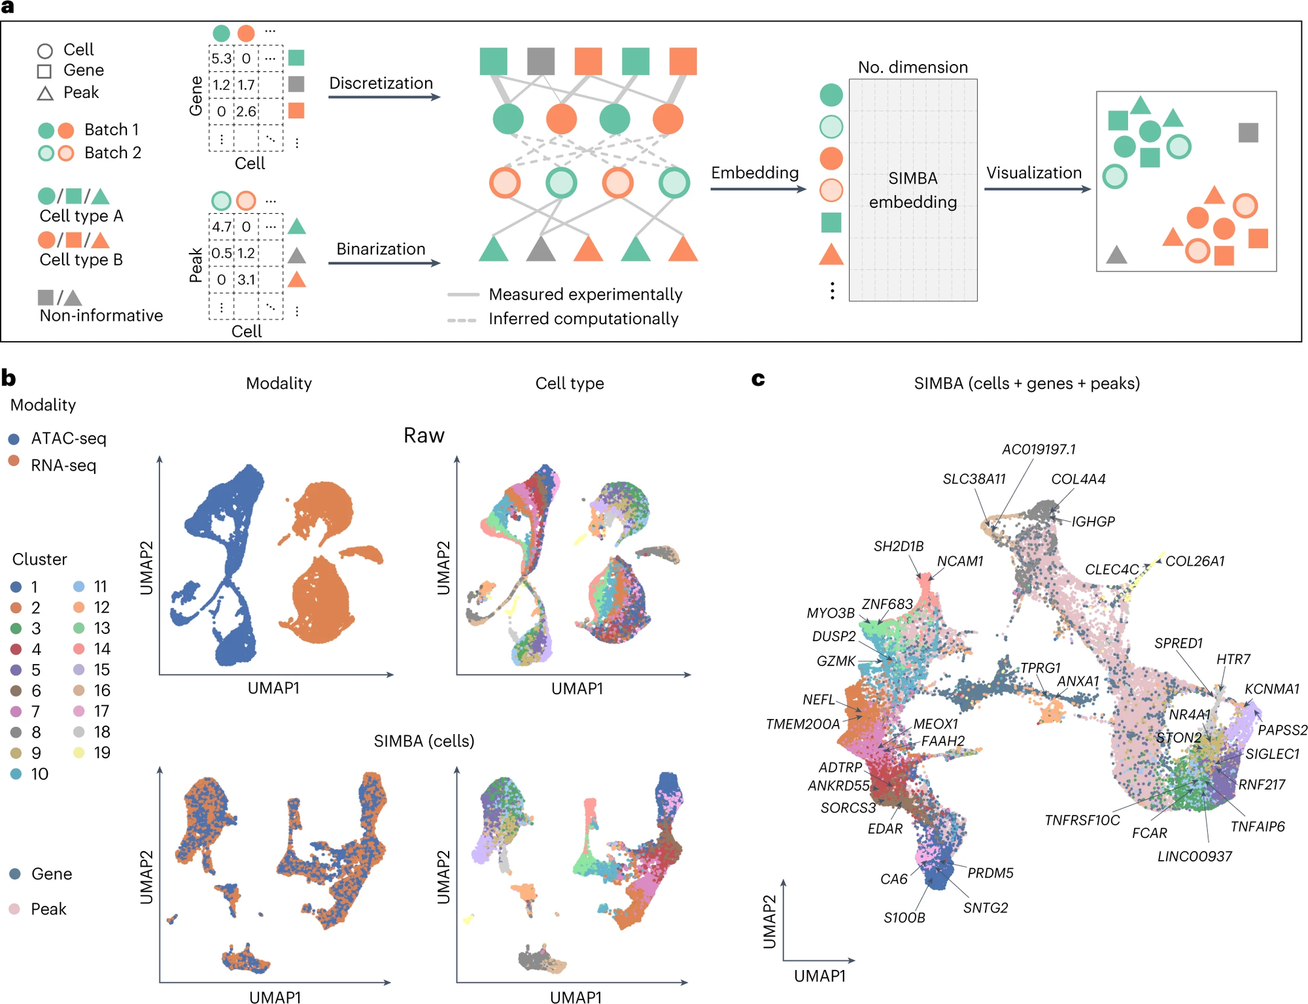
Multi-omics integration
Notes:
The last, is Multi-omics integration.
The top figure presents the UMAP visualization before integration.
The bottom figure displays the UMAP visualization after integration using SIMBA.

Slide 36
Methods
1. Preprocessing
2. Graph Construction
3. SIMBA Embedding
Notes:
We have finally arrived at the highlight of this paper.
In summary, it is divided into three steps

Slide 37
Methods
1. Preprocessing
2. Graph Construction
3. SIMBA Embedding
Notes:
I will discuss the first and second steps together, as the first and second steps in the five applications are very similar.

Slide 38
Single-cell RNA seq Analysis
K-means
Preprocessing
Graph Construction
Embedding
Filtering
Normalization
Variable gene selection
Notes:
Here, You can always see three steps. – Preprocessing, Graph Construction, and Embedding.
Preprocessing is simple, ehen we obtain the gene expression levels of cells, we tend to transform them into a gene expression matrix. You can see that, on this gene expression matrix, the values are continuous and include decimal points.
To simplify, we will transform these continuous values through a discrete conversion. We divide these values into five groups.
Each group here implies that the gene expression levels within the same group are relatively similar
After completing the conversion of discrete values, we can do the graph construction.
Graph construction is very easy, you put cells and genes on a graph. Circles represent Cells, and Squares represent Genes.
You know their relationship, you know which genes expressed in which cells, and you also know the value, the value is their expression level.
So based on their association, you can line them up. And this, is graph construction!
We will discuss SIMBA embedding later.

Slide 39
Single-cell ATAC-seq analysis
Preprocessing
Graph Construction
Embedding
Filtering
Peak selection
Notes:
It's quite clever that, as we just mentioned, the first five applications we discussed all follow a similar process.
If we now take another look at the ATAC data, they also conducted data preprocessing beforehand.
However, the conversion of values here is a bit different. They performed binarization.
Because they only wanted to categorize chromatin accessibility as either 'open' or 'closed.
And Here, you can do the same thing to TF motif data and k-mer. After transformation, You can perform graph construction similar to the previous one.
Peak selection (truncated-SVD) 包括 find main peak (elbow plot，前k個Pcs)、pick peak (knee point detection algorithm)、combine peak (variable peaks)
truncated-SVD：只保留具有信息的peak
PCs selection(elbow): 降維，把主幹挑出來，同時達到去噪
peak pick (knee point detection algo.)
Variable peaks combination

Slide 40
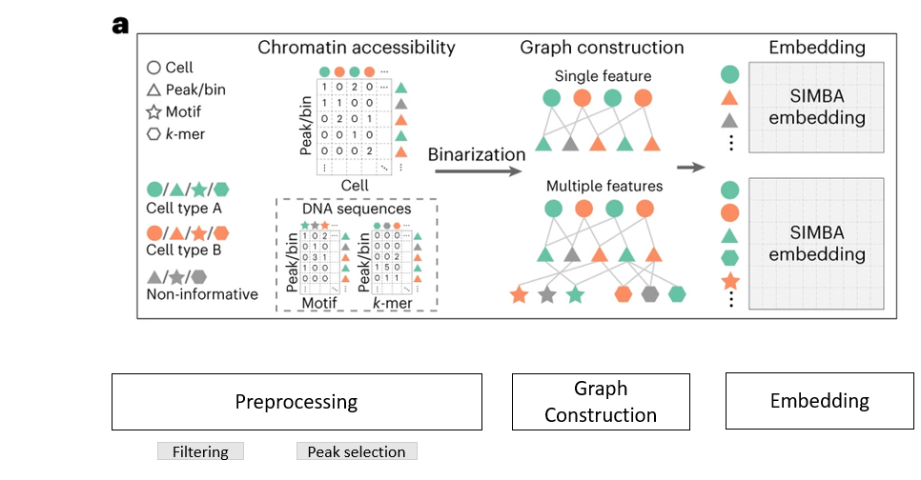
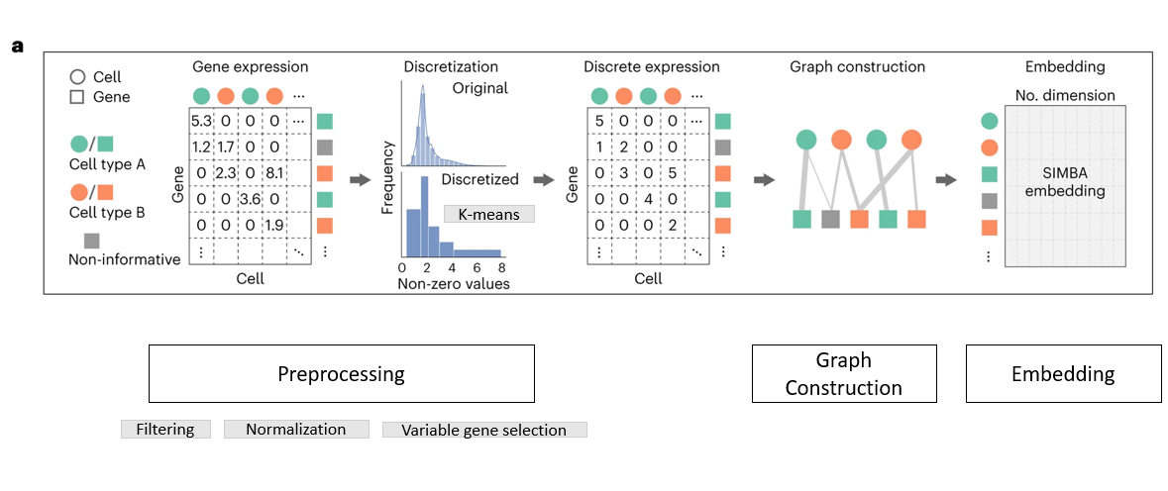
Multimodal Analysis
Single-cell ATAC-seq analysis
Single-cell RNA seq Analysis
Notes:
The concept of multimodal analysis is essentially the combination of the two previous approaches.

Slide 41
Multimodal Analysis
Preprocessing
Graph Construction
Embedding
Notes:
On the left, we have the approach for processing RNA data, while on the right, we have the approach for processing ATAC data

Slide 42
Batch correction analysis
Preprocessing
Graph Construction
for every batch
Embedding
Notes:
Batch correction analysis is essentially the same, but it involves constructing different graphs for different batches
So, here you can see many graphs
* truncated randomized SVD

Slide 43
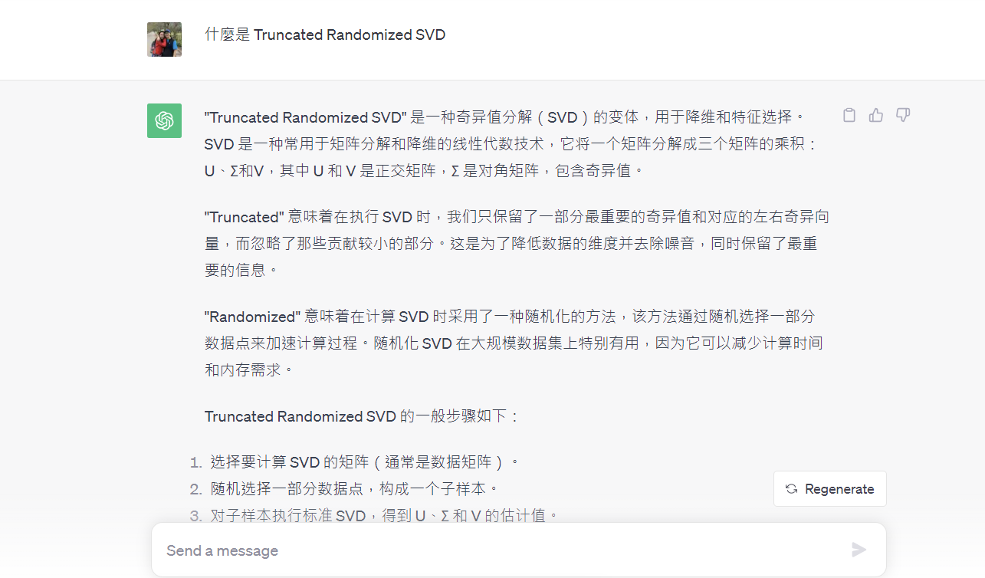
About Truncated Randomized SVD…
Notes:
Truncated-SVD based vs. Truncated randomized SVD
Truncated-SVD based：用于降维和特征选择的方法。在这种情况下，Truncated-SVD用于选择和保留最重要的峰（peak）或箱子（bin），以加速分析并减少维度
Truncated randomized SVD：用于整合不同批次（batch）之间的单细胞RNA-seq数据。目的是通过分析共享特征来推断不同批次之间细胞之间的关系

Slide 44
Multi-omics Integration
Graph Construction
(scRNA and scATAC data)
Graph Construction
Embedding
Notes:
Let’s not go into further about Multi-omics Integration; it's the same concept.
* Gene activity calculation
* truncated randomized SVD

Slide 45
Methods
1. Preprocessing
2. Graph Construction
3. SIMBA Embedding
Notes:
In fact, the most important part of this paper is the SIMBA embedding.
You may want to ask, how is the data normalized across different batches?
How do you integrate different datasets together?
or Why does using SIMBA embedding enable the construction of a world that lining up different features together?

Slide 46

Vector
Pytorch-BigGraph
destination entity
edge = (u, v)
source entity
a common latent space
Calculate “edge score” based on the connection
Calculate “loss” to evaluate the score
Find the overall best score
Notes:
Ok, so for SIMBA embedding…
First, we need to create a vector. Vectors are our input for SIMBA embedding.
We represent each edge existing in this space with a set of vectors.
An edge connects a starting position to an ending position. We call the node at starting position as “source entity”, and we call the node at ending position as “destination entity”
And then, we calculate an edge score for each edge. The score is related to the two nodes connected by the edge. This score reflects our aim to find a method to effectively capture the connectivity relationships between points.
Then we calculate the loss. Loss is a method used to assess whether these scores are sufficiently good. It is an evaluation for these scores.
Find the overall best score means, we will adjust our score and seeing if these scores become increasingly better, meaning they approach the true connectivity relationships more closely.

Slide 47
Negative Sampling
Create the wrong edge
a common latent space
Notes:
And the next step we need to do is to create some wrong edges, It means those edges that shouldn't exist in the reality at all.
But why do we need to do this?

Slide 48


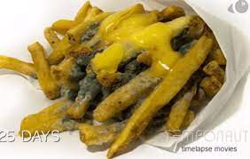
Negative Sampling
Yummy
Yummy
Notes:
Imagine you have a lot of food today. You want to teach your robot to distinguish whether food is tasty or not.
But if, during the teaching process, you only tell it that these are tasty foods without informing it that some foods are actually inedible, they are rotten, no one should eat it.
It will still perceive these as tasty foods.

Slide 49
Negative Sampling
Yummy
Disgusting
rotten food = disgusting
Notes:
So, it's crucial to inform it that some foods are inedible, they are disgusting.

Slide 50
Negative Sampling
Create the wrong edge
a common latent space
Calculate the weight of each edge
Calculate the score
Notes:
This is the key point of negative sampling, not only creating incorrect connections to indicate which connections should not exist. For points with stronger associations, we should also assign higher weights to reflect their strong relevance. Finally, based on the strength or absence of these relationships, compute the corresponding scores.

Slide 51
Evaluation
Model Training
Notes:
Let's now talk about how to determine if this machine is good or not

Slide 52
Can our model predict precisely?
In this case….
The connection of the edges and nodes
a common latent space
MRR（Mean Reciprocal Rank）
R1: the frequency of the correct answer is ranked first
R10: same above, but range is wider to 10%
R50: same above, but range is wider to 50%
AUC（Area Under the Curve）
Notes:
We might all wonder, how do we know if what this machine says is correct? Is it accurate enough to predict the connections between different features?
Therefore, SIMBA adopts five metrics to evaluate the goodness of a model.
The first one is “Mean Reciprocal Rank”.
Because I want to be simple. So Imagine this, you search for a question on Google, and Google provides you with a bunch of answers. The correct answer might be the first one, or the second one, or possibly further down the list. MRR is a method that measures, on average, how many answers you need to look at before finding the correct one.
The "R1" focuses specifically on the first item in that list. Each time you seek the correct answer, how high is the probability that the correct answer is the first one?
Same as R10 and R50, how high high is the probability that the correct answers shows within 10% or 50%
AUC, most of us are familiar with this. An important metric used to evaluate the performance of classification models. Judging an edge to truly exist in the world, and that edge does indeed exist, results in a high AUC.
On the contrary, predict wronly, indicate that the model does not classify well, resulting in a low AUC

Slide 53
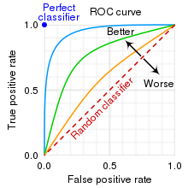
Can our model predict precisely?
How good is the model?
AUC can tell us
https://en.wikipedia.org/wiki/Receiver_operating_characteristic

Slide 54
Evaluation
cell-type specificity
= clustering-free method

Slide 55




Metrics to assess cell-type specificity
Cells and Features…
How to evaluate that they are related?
Max Score
Gini Index
Standard Deviation
Entropy
Association
Specificity
Variance
Degree of Disorder
The evenness of Distribution

Slide 56

Metrics to assess cell-type specificity
The similarity normalization function:

Slide 57
PyTorch-BigGraph (PBG)

Slide 58
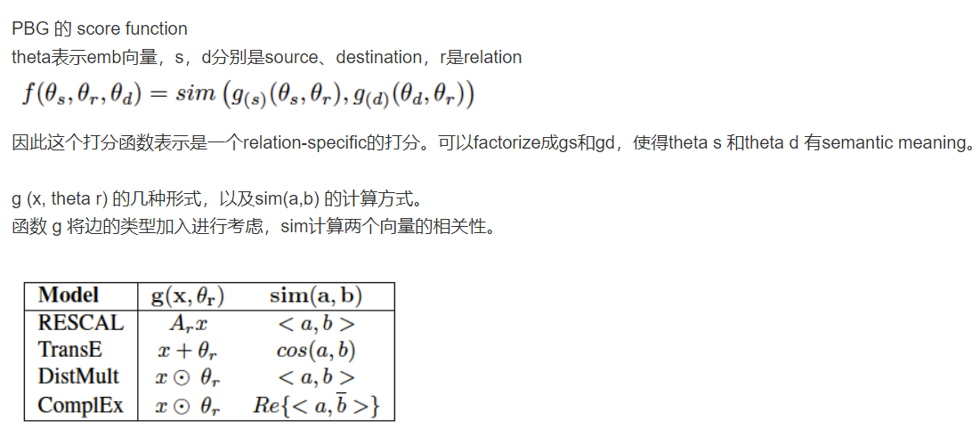
PBG Concept
將圖分解成N個桶，一次訓練一個桶的邊
PBG
(1) 支持多實體
(2) 能高效對節點進行負採樣
Notes:
https://zhuanlan.zhihu.com/p/108441063

Slide 59

Discussion
SIMBA
https://zh.wikipedia.org/zh-tw/%E8%BE%9B%E5%B7%B4
Notes:
Before we dive into the discussion, I'd like to make a declaration. Due to time constraints, there are many mathematical concepts and details behind SIMBA that I have not mentioned. If anyone is interested, you can just come to seek me out for further discussion

Slide 60
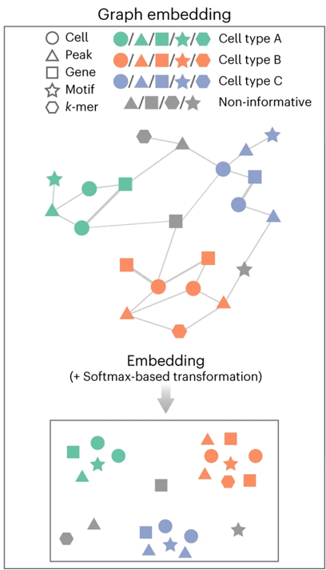
The Great Idea of SIMBA
a common latent space

Slide 61

SIMBA！To do more？
cellular heterogeneity
time points
Perturbations
regulatory mechanisms
https://www.timesofisrael.com/israeli-photographers-real-life-lion-king-photo-grabs-headlines/
Notes:
In the discussion, SIMBA believes it has successfully accomplished two things. First, through SIMBA, we can clearly differentiate various cell types. Secondly, it allows us to understand the regulatory mechanisms among genes, transcription, and chromatin factors within a single cell.
However, is there a chance to incorporate more variables in the future?
For instance, time points, or some interfering factors？
Indeed, with each additional variable, we are essentially adding another dimension to the data, which may complicate the analysis significantly. However, it‘s a matter worth considering for everyone.

Slide 62

Thank you
https://en.wikipedia.org/wiki/Simba
Notes:
Thanks for your listening, this is the end of my presentation. Do you guys have any question?

Slide 64
SIMBA 實作
安裝安到找不到北

Slide 65
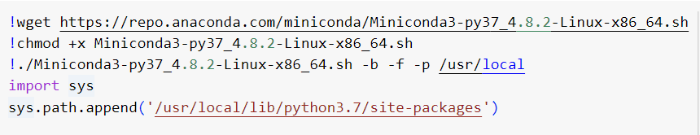
建置環境
在 Google Colab 中載入 Conda

Slide 66
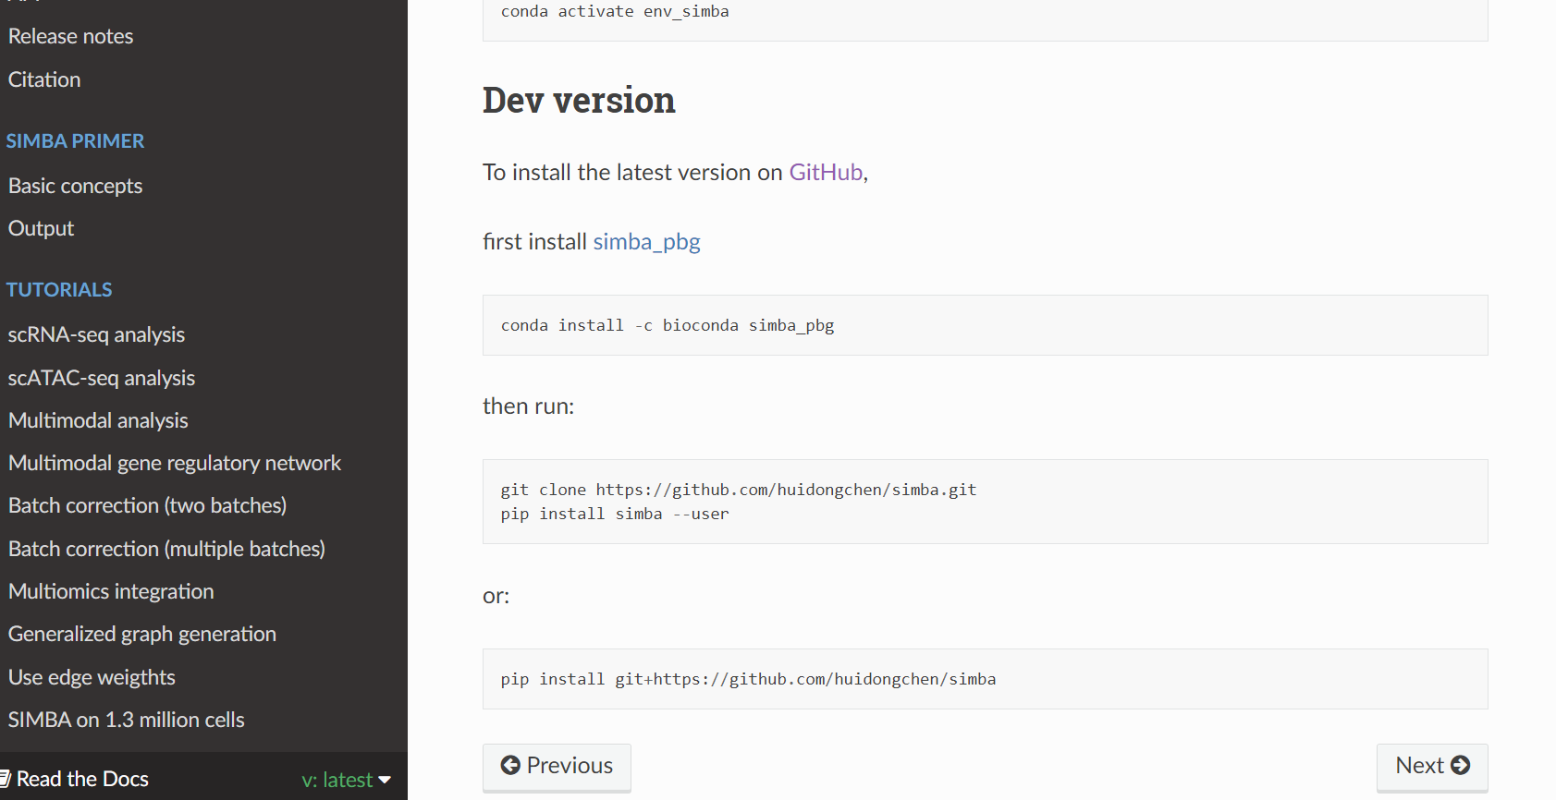

Slide 67
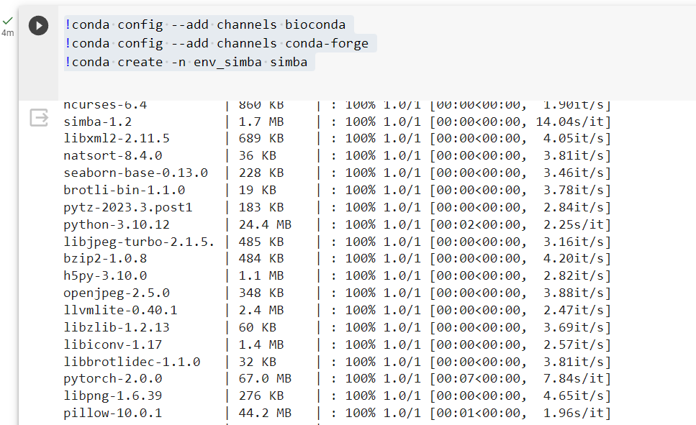
我想像中的安裝
先 Load Bioconda
再安裝 simba
最後 Create Env
https://simba-bio.readthedocs.io/en/latest/Installation.html
Notes:
simba 如果沒有 Bioconda 不可用。你需要添加 bioconda 頻道到你的 conda 頻道列表中，因為 simba 是從 bioconda 頻道提供的

Slide 68
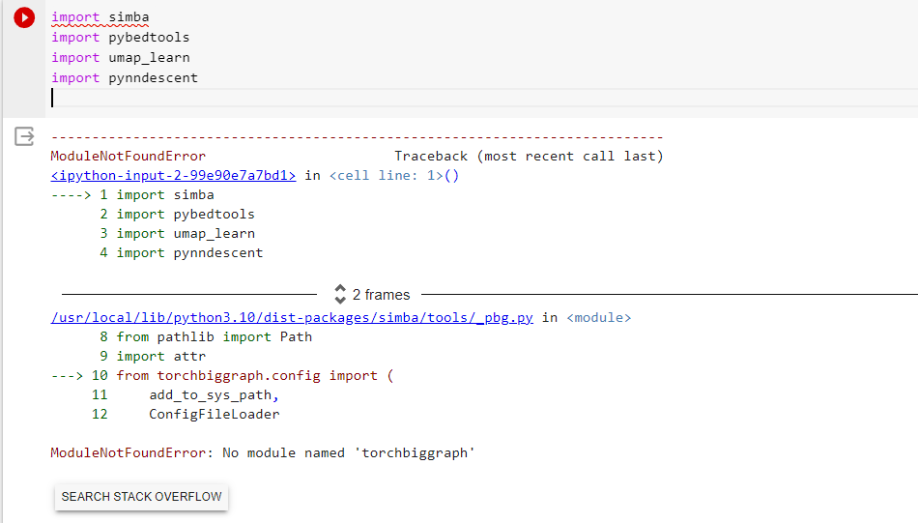
實際上的安裝
做完之後
Import SIMBA
瘋狂失敗

Slide 69
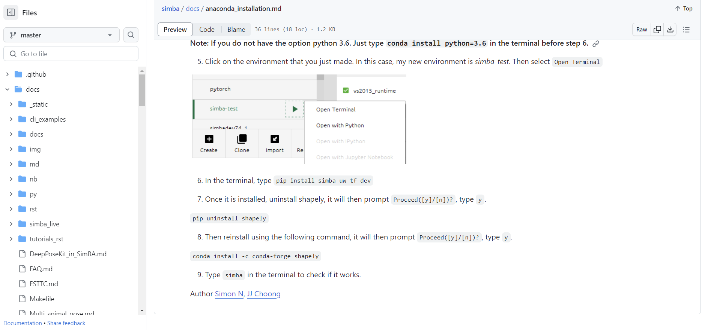
求救 Github
https://github.com/sgoldenlab/simba/blob/master/docs/anaconda_installation.md

Slide 70
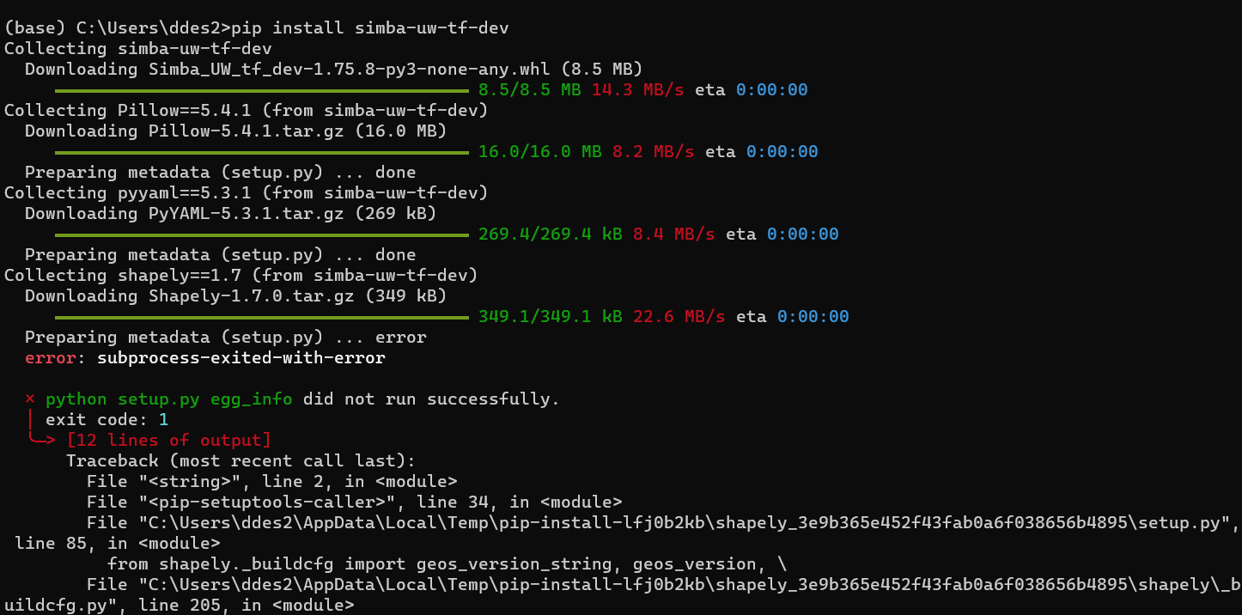
繼續在失敗中打滾

Slide 71
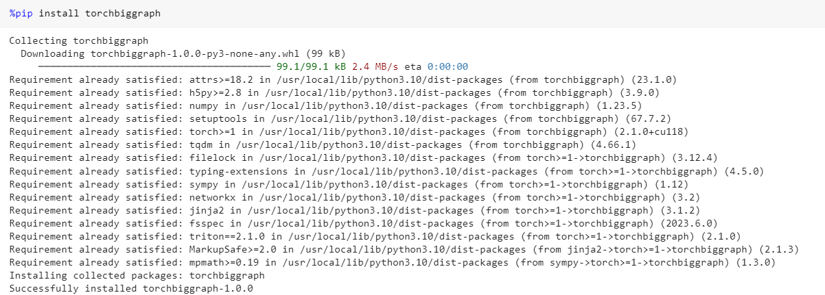
連 PyTorch都要裝上去了
因為 import simba 時，出現 NoModule “PyTorch”的情況

Slide 72
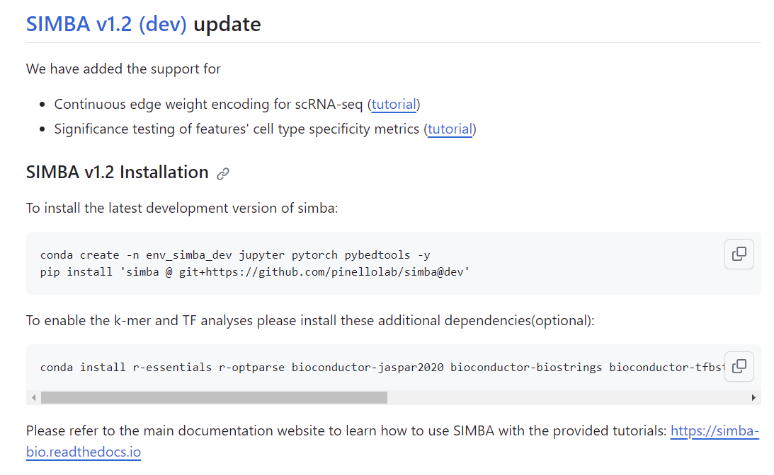
解救安裝的最後一根稻草
https://github.com/pinellolab/simba

Slide 73
發生了什麼？

Slide 74
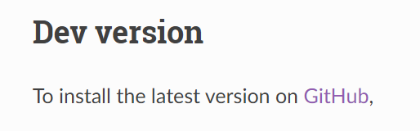
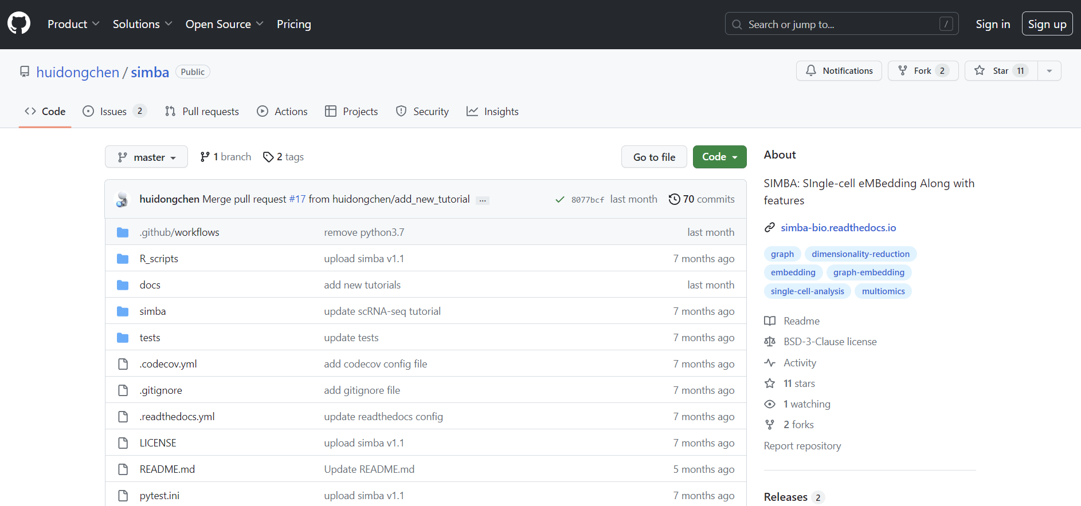
SIMBA網站上給的GitHub
https://github.com/huidongchen/simba

Slide 75
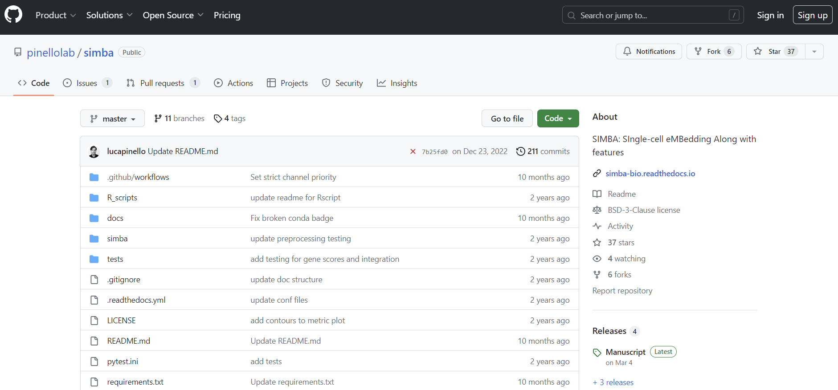
實際安裝用的GitHub
https://github.com/pinellolab/simba/tree/master/simba/datasets

Slide 76
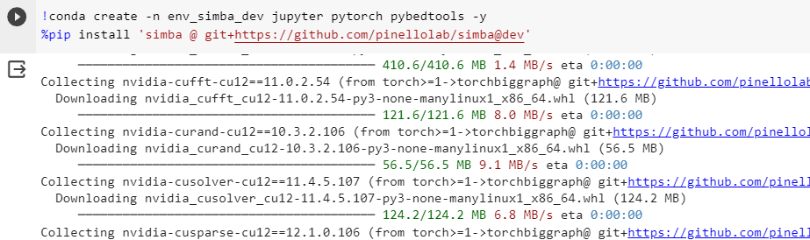
安裝 SIMBA 的正確指令
Google Colab

Slide 77
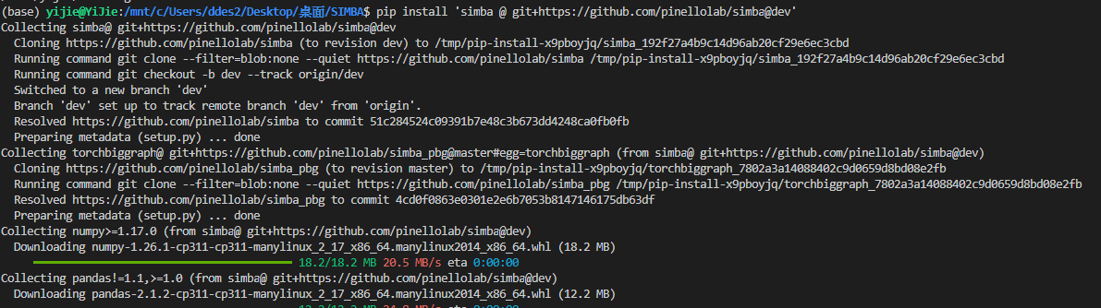
安裝 SIMBA 的正確指令
Vscode Terminal

Slide 78
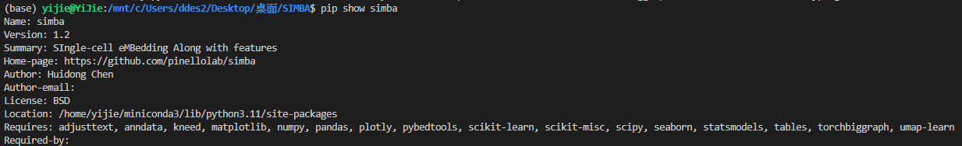
查看 SIMBA 版本號

Slide 79
SIMBA - scRNA Analysis

Slide 80

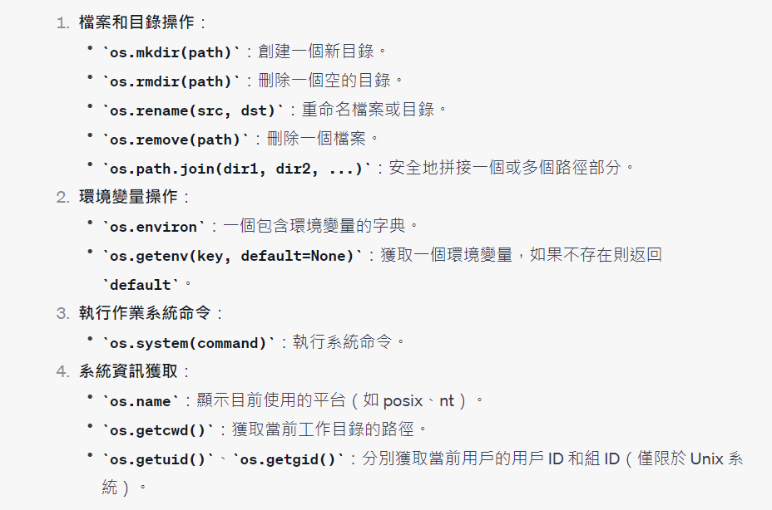
Import os
導入名為 "os" 的標準庫模組
提供方法與作業系統進行互動。包括文件和目錄的創建、刪除和修改，以及獲取環境變量和執行系統命令等功能

Slide 81
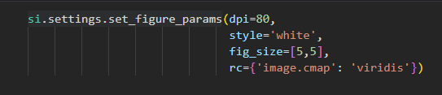
si.settings.set_figure_params()
Notes:
dpi=80
dpi 代表 "dots per inch"，即每英寸的點數。此參數設置圖形的解析度。80 是一個常見的dpi值，意味著每英寸有80個點。
style='white'
這可能是設置圖形背景的颜色或樣式。在這裡，背景樣式被設置為'white'。
fig_size=[5,5]
fig_size 可能是用於設置圖形的大小。在這裡，圖形的寬度和高度都被設置為5（可能是英寸或其他單位）。
rc={'image.cmap': 'viridis'}
rc 可能是用於設置或更新 matplotlib 的運行時配置參數。
在這個字典中，'image.cmap': 'viridis' 設置了圖像的colormap（顏色映射）為 'viridis'。'viridis' 是一個在matplotlib中常見的colormap，它是一個從藍色到黃色的顏色範圍。

Slide 82

import set_matplotlib_formats
Notes:
from matplotlib_inline.backend_inline import set_matplotlib_formats
從matplotlib_inline.backend_inline模組導入了set_matplotlib_formats函數。matplotlib_inline是Jupyter Notebook和Jupyter Lab中用於顯示matplotlib圖形的backend。
set_matplotlib_formats('retina')
這行代碼呼叫set_matplotlib_formats函數，並將格式設為'retina'。
'retina'格式是針對具有高解析度（如Apple的Retina顯示）的顯示器而設計的。該格式使圖形在這些顯示器上看起來更加銳利和清晰

Slide 83
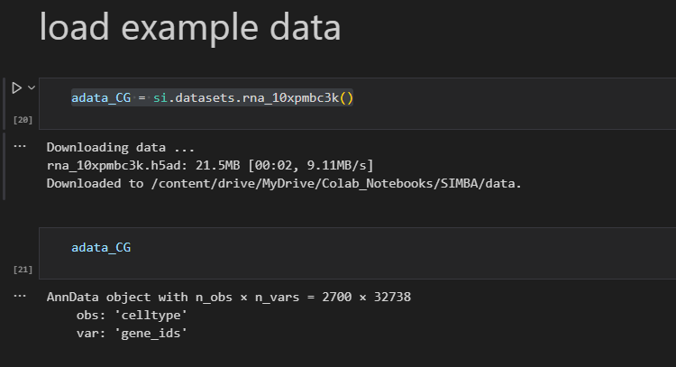
Load Data

Slide 84
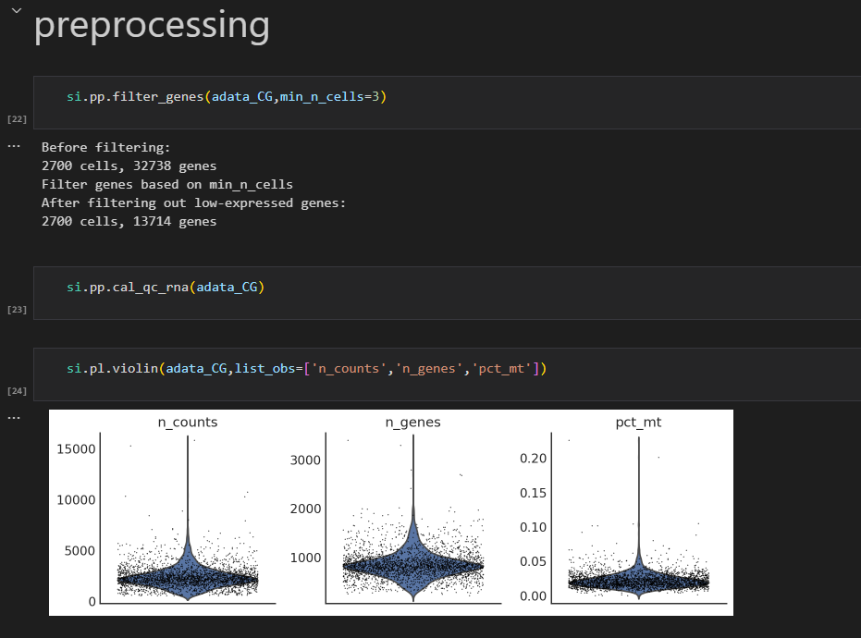
Preprocessing

Slide 85
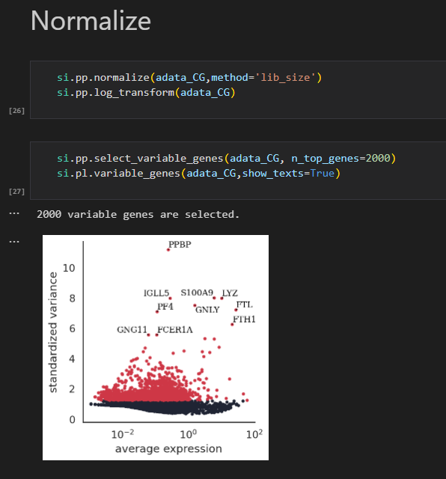
Normalize

Slide 86
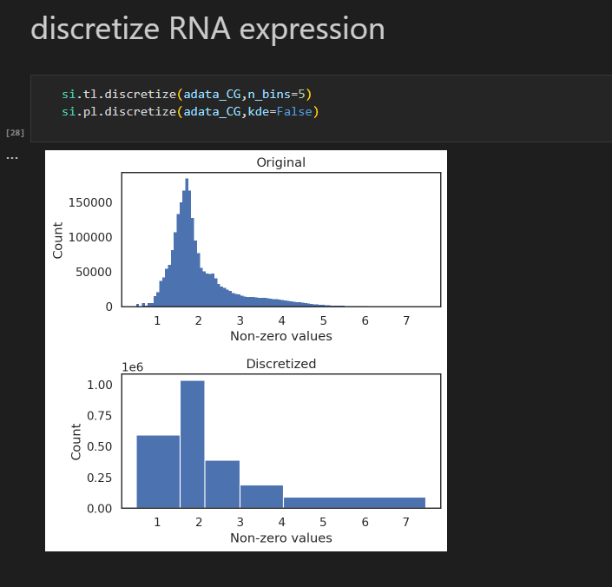
Discretize RNA expression

Slide 87
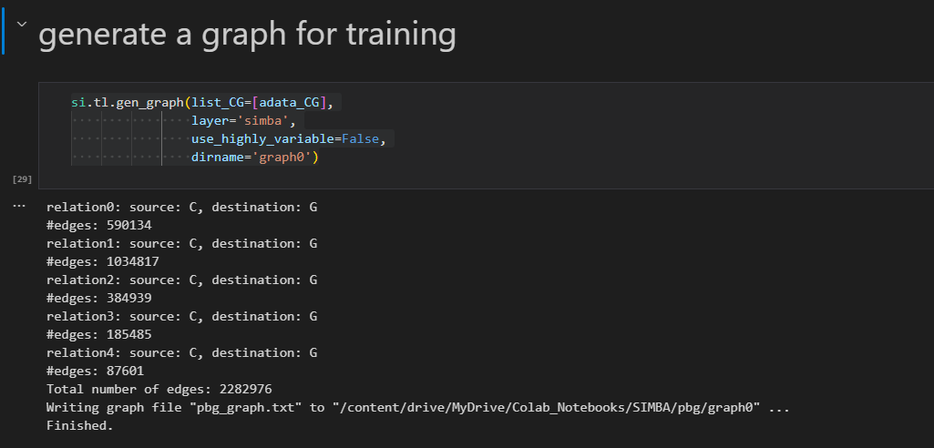
Generate a Graph for training
Notes:
list_CG=[adata_CG]: 這個參數接受一個列表，其中包含adata_CG，即前面加載的RNA數據集。
layer='simba': 這可能是指示函數使用哪個數據層來生成圖的參數。在這裡，它被設置為'simba'。
use_highly_variable=False: 這個參數可能控制是否只使用高度變異的基因或特征來生成圖。在這裡，它被設置為False，這意味著它將使用所有的基因或特征，而不僅僅是高度變異的那些。
dirname='graph0': 這個參數可能是指示生成的圖應該被保存在哪個目錄中的。在這裡，它被設置為'graph0'，所以生成的圖應該會被保存在名為'graph0'的目錄中。

Slide 88
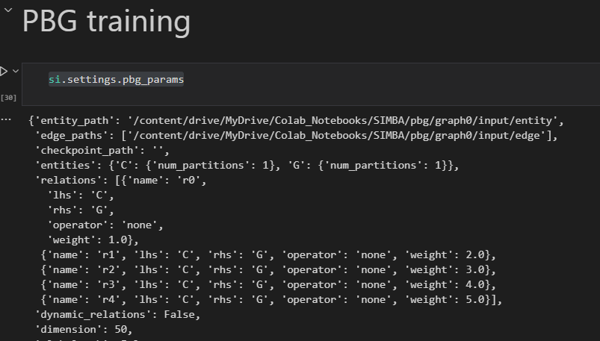
PBG training - parameters
Notes:
'entity_path': 存儲entity數據的路徑。
'edge_paths': 存儲edge數據的路徑列表。
'checkpoint_path': 可能是保存模型訓練過程中的中間檢查點的路徑。
'entities': 描述不同類型的實體及其分區。
'relations': 定義了不同的關係，每個關係都有名稱、左邊實體、右邊實體、運算符和權重。
'dynamic_relations': 表示關係是否是動態的。
'dimension': 嵌入的維度或大小。
'global_emb': 是否使用全局嵌入。
'comparator': 比較嵌入的方法，這裡是“dot”即點積。
'num_epochs': 訓練的總迭代次數。
'workers': 用於數據加載和計算的工作線程數。
'num_batch_negs': 每批數據的負樣本數量。
'num_uniform_negs': 從均勻分佈中抽取的負樣本數。
'loss_fn': 損失函數的類型，這裡是“softmax”。
'lr': 學習率。
'early_stopping': 是否使用早期停止以防止過度擬合。
'regularization_coef': 正則化係數。
'wd': 權重衰減。
'wd_interval': 權重衰減的間隔。
'eval_fraction': 用於評估的數據分數。
'eval_num_batch_negs': 評估時每批的負樣本數。
'eval_num_uniform_negs': 評估時從均勻分佈中抽取的負樣本數。
'checkpoint_preservation_interval': 保存檢查點的間隔

Slide 89
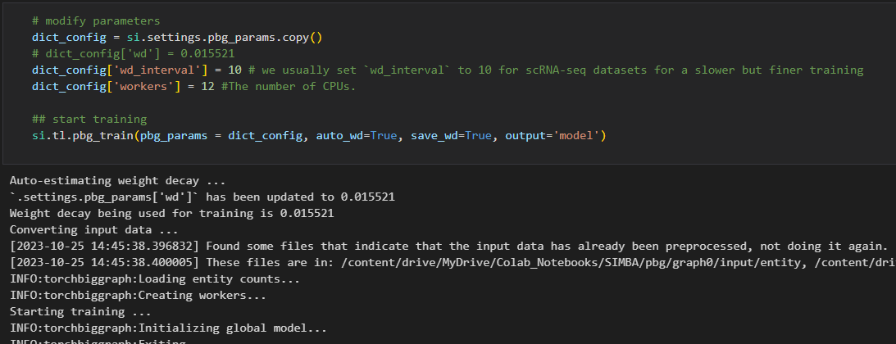
更改超參數
用 si.tl.pbg_train() 這個函數就可以直接train了

Slide 90
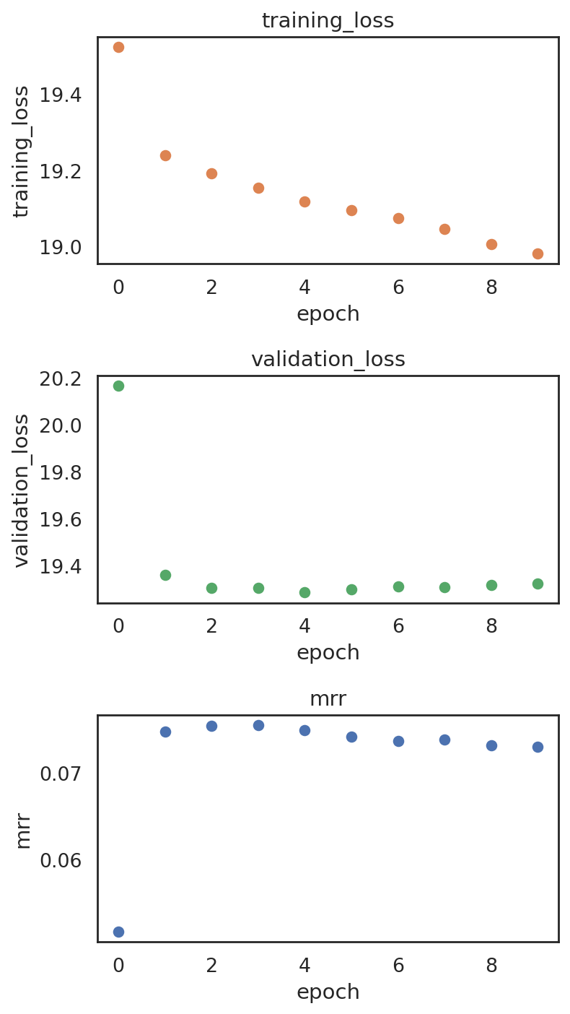
檢測 overfitting
si.pl.pbg_metrics(fig_ncol=1)
Notes:
Plotting training metrics to monitor overfitting and evaluate the final model.
繪製訓練指標（如損失或準確率）的圖形可以幫助監控模型是否過度擬合。過度擬合發生在模型在訓練數據上表現得很好，但在沒見過的驗證或測試數據上表現不佳的情況。
Ideally, after a certain number of epochs, the metric curve should stabilize and remain steady.
在一定數量的訓練迭代（或稱為epochs）之後，期望指標曲線（如損失或準確率）穩定下來，不再有顯著的變化。這通常意味著模型已經學到了它可以從數據中學到的所有信息。
By default, training loss (lower is better) along with validation loss (lower is better) and MRR (higher is better) are shown.
三個常見的訓練指標：
training loss: 在訓練數據上的損失值。損失值越低，模型的預測就越接近真實值，所以這是一個“越低越好”的指標。
validation loss: 在驗證數據集上的損失值。這個指標也是“越低越好”。
MRR (Mean Reciprocal Rank): 這是一種評估模型性能的指標，常用於評估推薦系統或搜索排名等任務。對於MRR，越高越好，因為它代表模型在首次正確推薦或排名中的性能

Slide 91
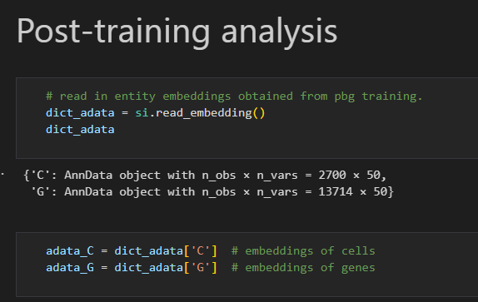
Post-Training Analysis

Slide 92
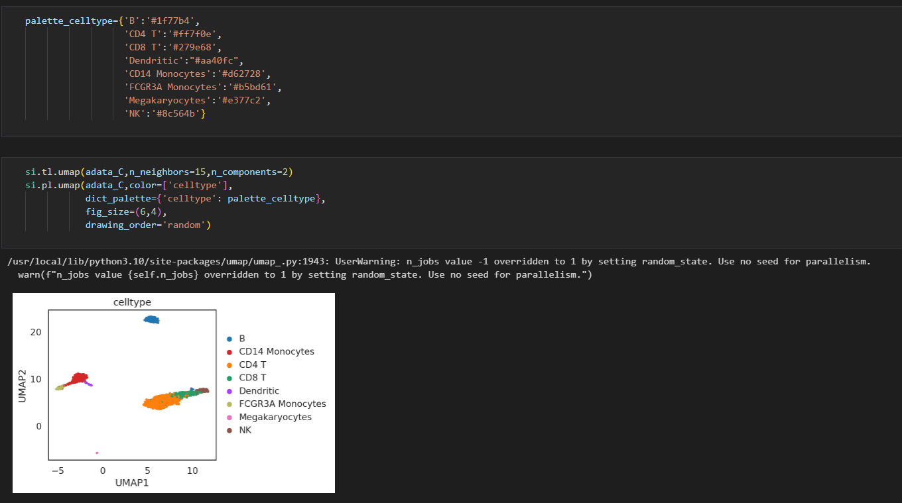
Visualize Cell Annotation

Slide 93
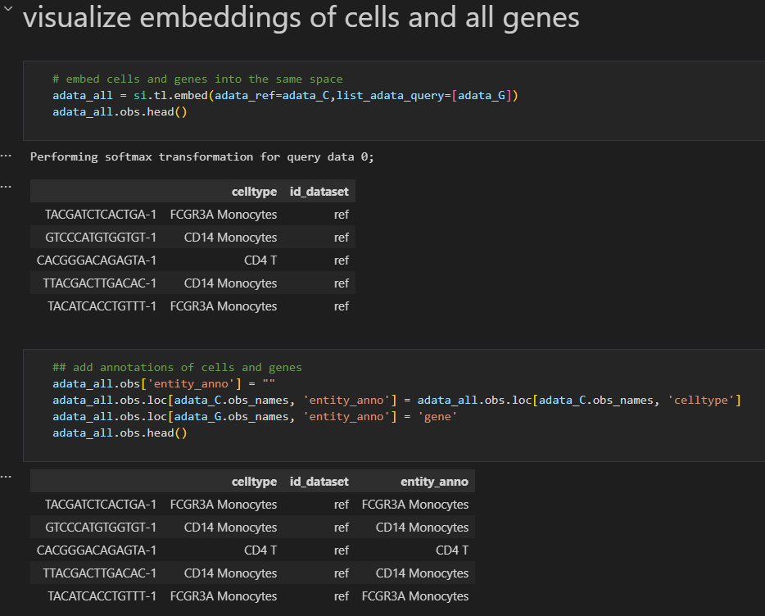
Visualize embeddings of cells and all genes

Slide 94
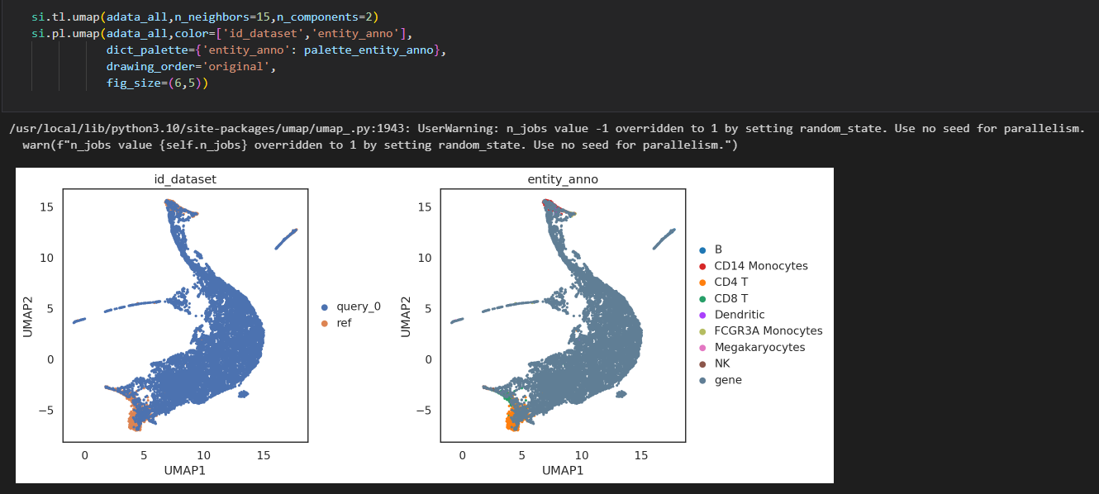
Draw UMAP

Slide 95
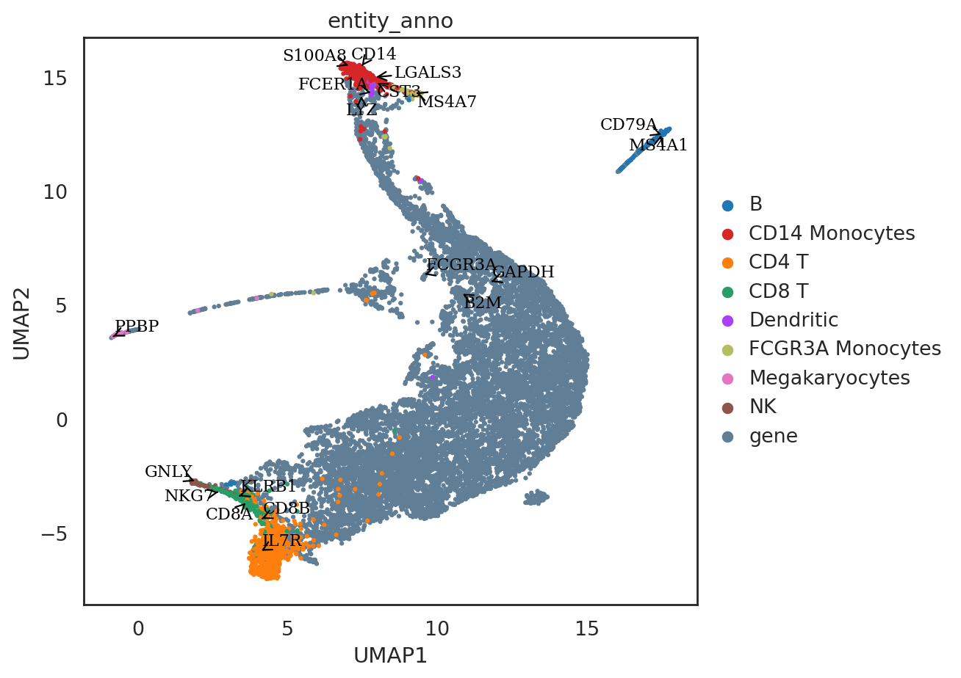
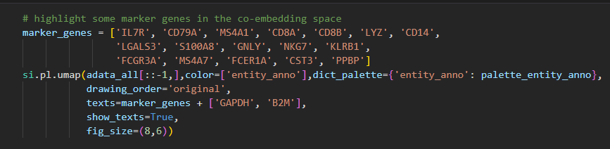
Highlight some marker genes

Slide 96
SIMBA - scATAC Analysis

Slide 97
Data Fetch
$ conda install
r-essentials
r-optparse
bioconductor-jaspar2020
bioconductor-biostrings
bioconductor-tfbstools
bioconductor-motifmatchr
bioconductor-summarizedexperiment
r-doparallel bioconductor-rhdf5
bioconductor-hdf5array
Notes:
r-essentials: 包含許多常用的R包的集合，這些包在R的日常數據分析中非常有用。
r-optparse: 一個R包，用於從命令行選項解析函數參數。
bioconductor-jaspar2020: Bioconductor包，提供了JASPAR 2020數據庫的數據，這是一個廣泛使用的轉錄因子結合位點模型的集合。
bioconductor-biostrings: 用於操作生物學中的字符串數據（例如DNA、RNA和蛋白質序列）的Bioconductor包。
bioconductor-tfbstools: Bioconductor包，用於轉錄因子結合位點的分析和視覺化。
bioconductor-motifmatchr: 用於獲取轉錄因子結合到基因組的位置的Bioconductor包。
bioconductor-summarizedexperiment: 提供一個容器，用於存儲和操作生物學的數據集的Bioconductor包。
r-doparallel: R包，提供了一個簡單的API，用於在R中進行並行計算。
bioconductor-rhdf5: 用於讀寫HDF5文件的Bioconductor包。
bioconductor-hdf5array: Bioconductor包，提供了一種用於存儲在HDF5文件中的大數據集的數據結構。

Slide 98
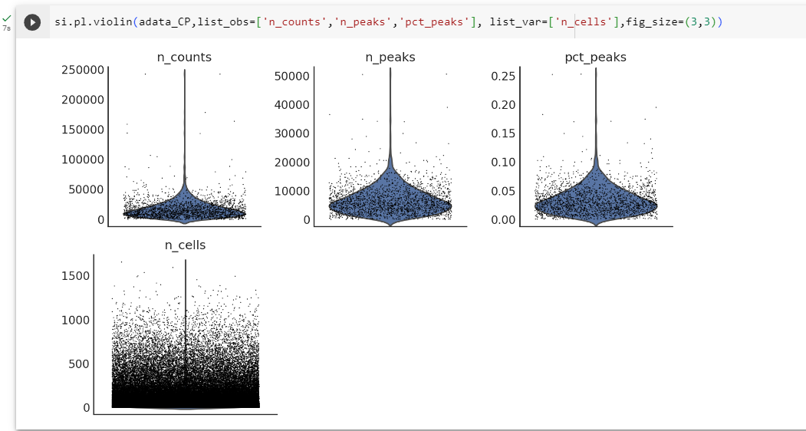
Preprocessing

Slide 99

Si.pl.hist()

Slide 100

對 peak 做降維
Notes:
It will speed up the trainning process by only keeping peaks associated with top PCs

Slide 101


Slide 102

選擇主成分
si.pl.pcs_features(adata_CP, fig_ncol=10)
Notes:
Select features associated with each of these PCs. The number of features for each PC will be automatically decided
主成分（PC）：每一小格的標題顯示了哪個主成分的特徵負荷被展示。例如，“PC 0”表示第一主成分。
特徵 (Features)：X軸表示特徵的數量。從這個圖可以看出，特徵的數量達到了數十萬。
負荷 (Loadings)：Y軸代表了特徵在該主成分中的負荷值。負荷值告訴我們該特徵在該主成分中的重要性。
紅色虛線：這些虛線似乎是用來標記某些特定的特徵或負荷值閾值

Slide 103
SIMBA - Multimodal Analysis

